Slide 1
Humanized tree assemblages in a barrier island landscape: Key Biscayne, Florida
M. Ross, C. Melo, J. Sah, G. Hollander and students of EVR 4596
Notes:
Stems from work done by upper level Environmental Studies students during and after Applied Field Ecology class in Spring 2011.
Offshoot of our ULTRA-MIA project.
Key Biscayne was chosen because of its size, discreteness, and range of land uses and management entities

Slide 2
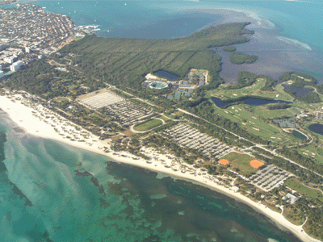
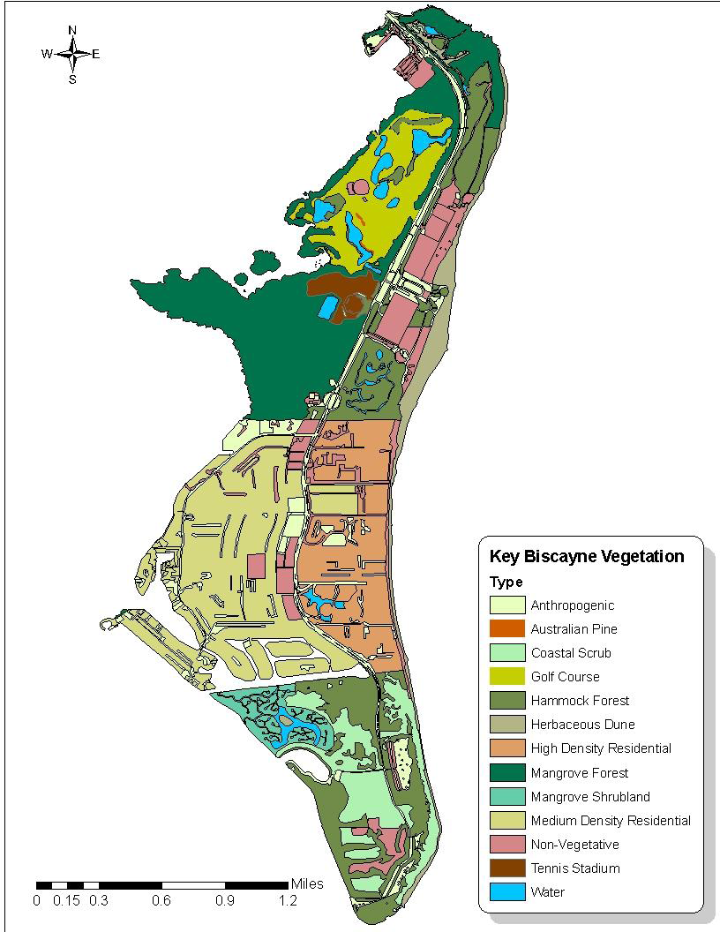
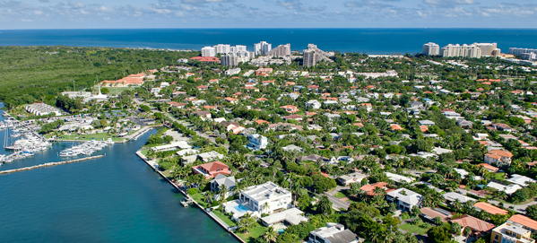
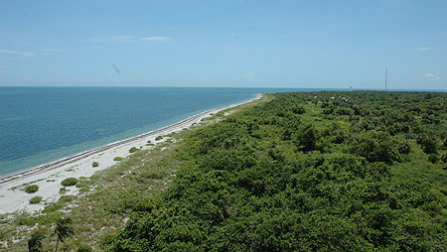
Key Biscayne today
Notes:
Key Biscayne today is effectively divided into three sections.
The north section is Crandon Park, operated by Miami-Dade County. It includes a golf course, a tennis stadium, a popular public beach, an extensive mangrove forest, a Nature Center, and some limited upland forest.
The middle section is the Village of Key Biscayne, a well-to-do community of ~10,000 residents with single family residences on west side and condominiums along the beach.
The southern is Bill Baggs State Park, a busy recreational area centered on an historical lighthouse, a long strip of beach and dunes, and restored upland forests, freshwater wetlands, and mangrove swamps.

Slide 3
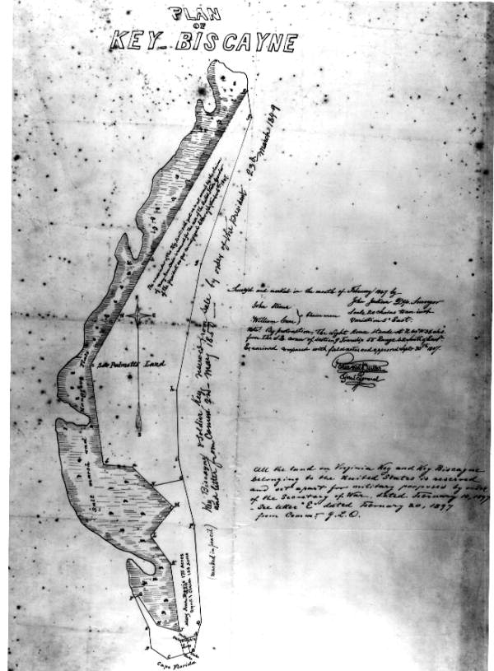
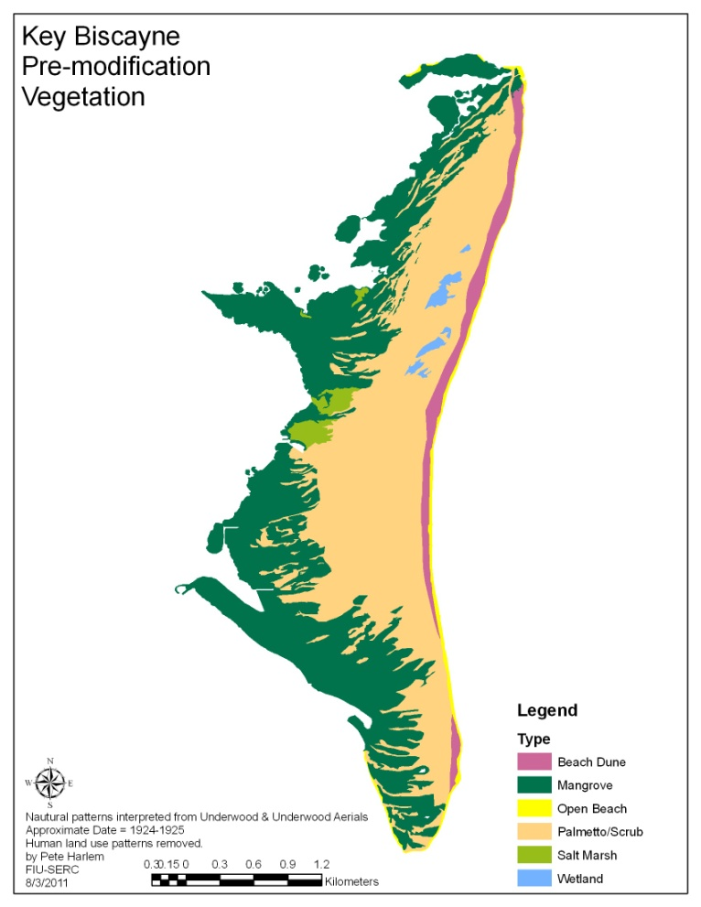
Key Biscayne prior to western settlement
Vegetation – mangroves and salt marsh, palmetto-dominated scrub, with scattered freshwater wetlands.
If present at all, upland forests were of limited extent.
Notes:
Initial vegetation most barrier islands has salt marsh species on the back side, and dune species on the axis of the island. In the case of south Florida barrier beaches, the salt marsh zone was primarily occupied by mangroves, and the dunes were occupied by a saw palmetto dominated scrub. The island had some fresh water holes, but little evidence of extensive well-drained forest.

Slide 4
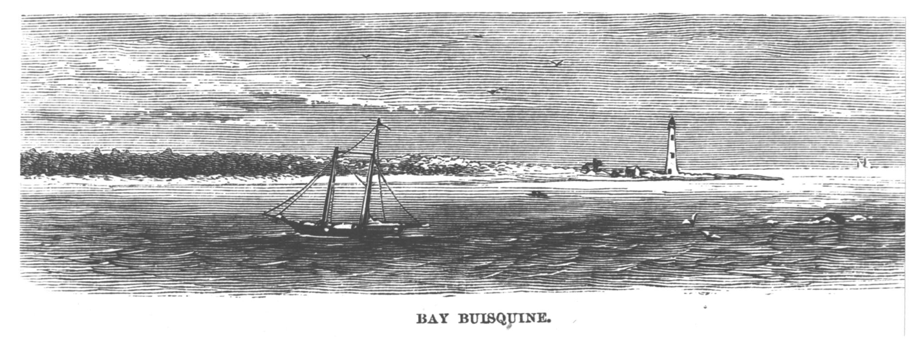
The lighthouse years in the 19th Century
Notes:
Lighthouse built in 1825, and naval operations from the island continued throughout 19th Century. Important base for prosecution of Indian wars and the Civil War, surveying of coastline.

Slide 5
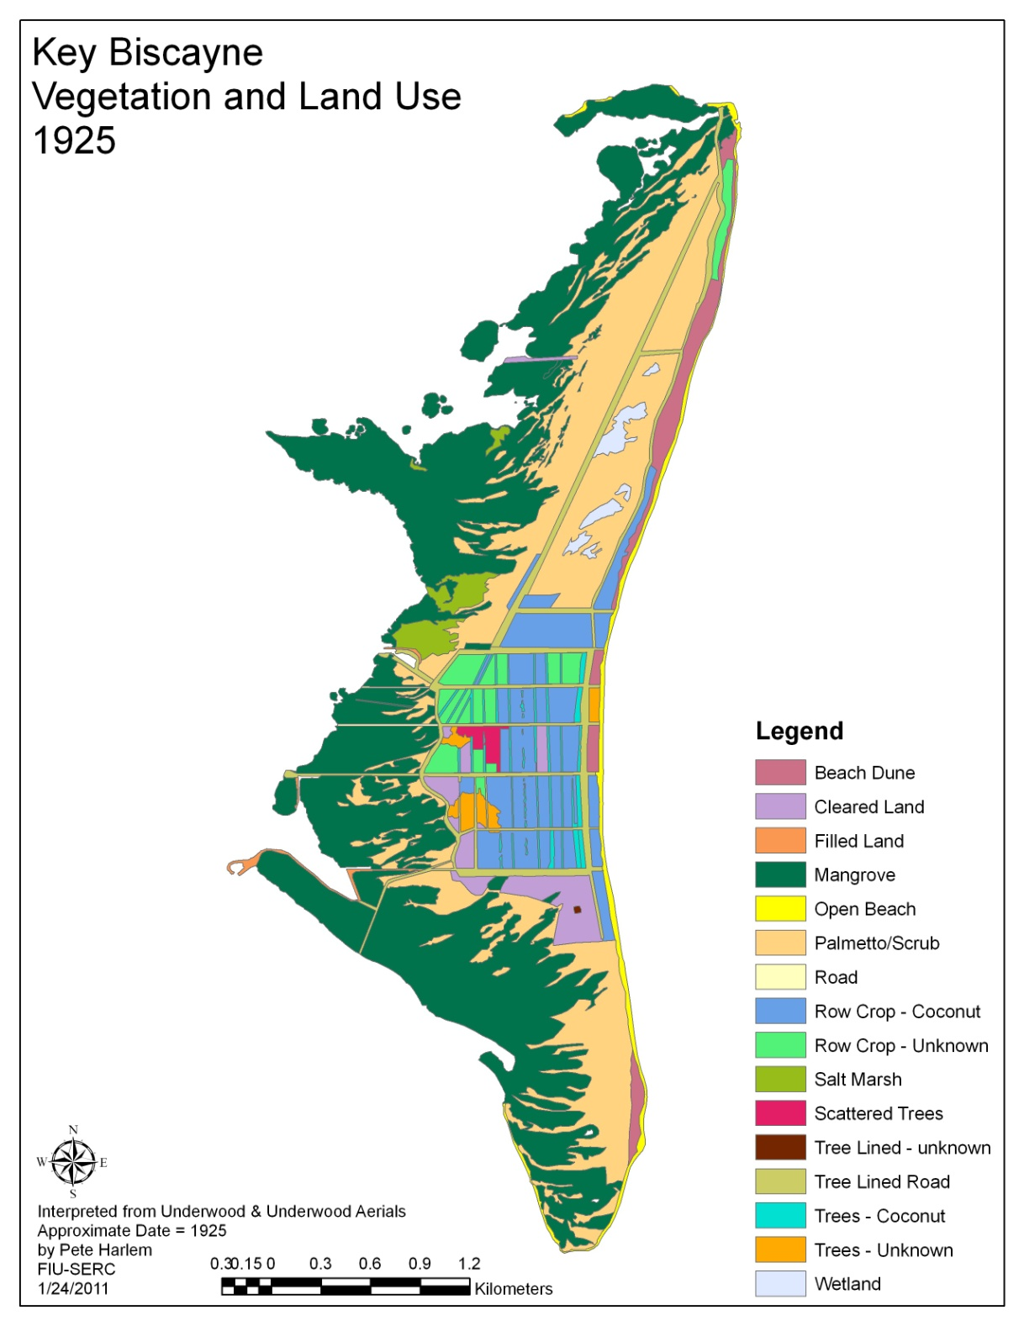
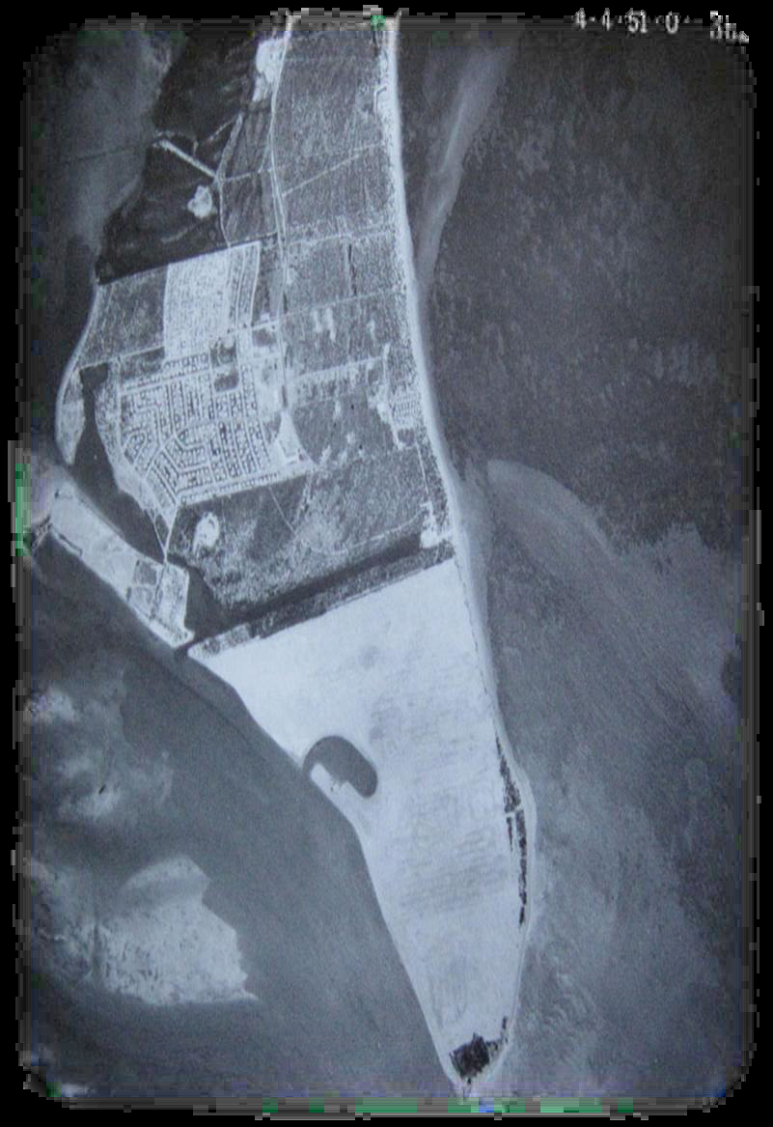
Urbanization in the 20th Century
Key Biscayne
1951
Notes:
By 1925, when the first aerial photos became available, a small settlement had developed around a coconut plantation on the middle of island.
In 1951, 4 feet of fill were deposited to raise and level the southern third of the island, in anticipation of development.
Later in the 1950’s the north end of the island was conveyed to Miami-Dade County for park and recreation purposes.
In 1967 the southern end of the island, which had never been developed and was colonized by exotic Australian pines, was acquired by the State of Florida, and became Bill Baggs Cape Florida State Park

Slide 6
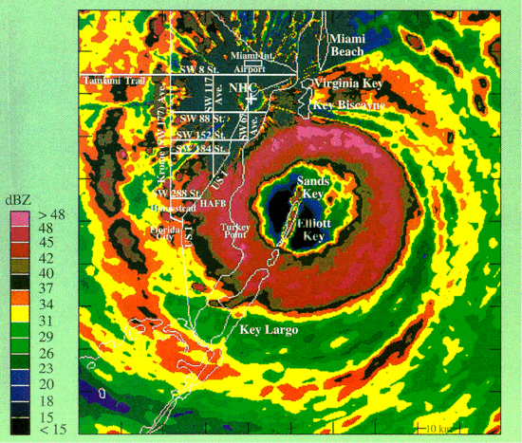
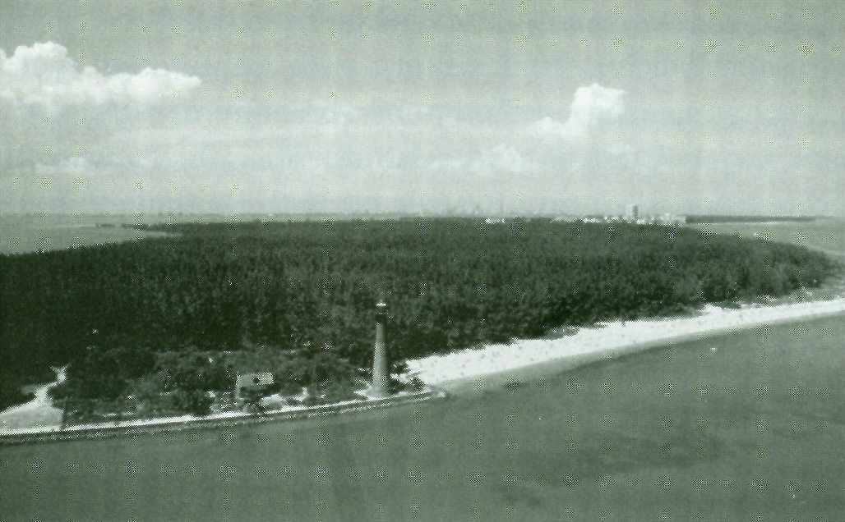
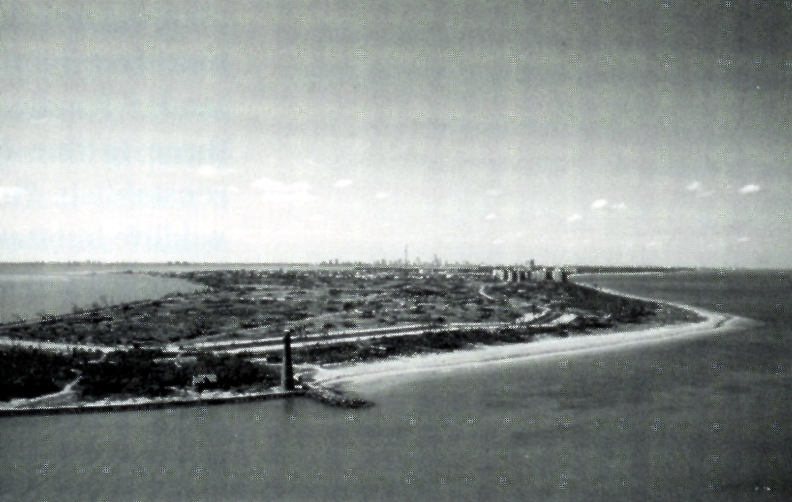
Hurricane Andrew August 1992
Leveled Australian pine forest on southern end of island.
Presented opportunities for restoration
Notes:
In 1992, intense winds from Hurricane Andrew uprooted and broke almost all the Australian pines which had colonized the filled area at the south end of the island, and presented an opportunity for restoration of some of the original communities that had occurred there prior to the 20th century.

Slide 7
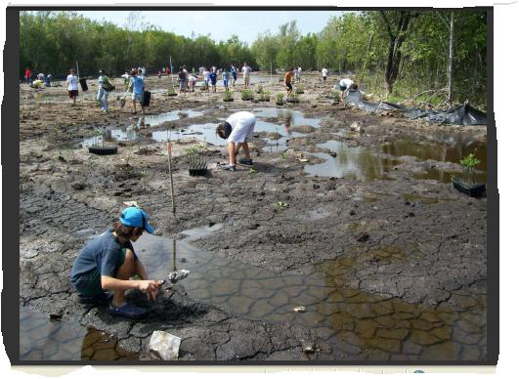
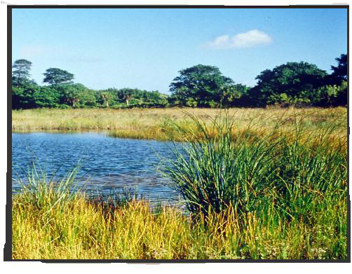
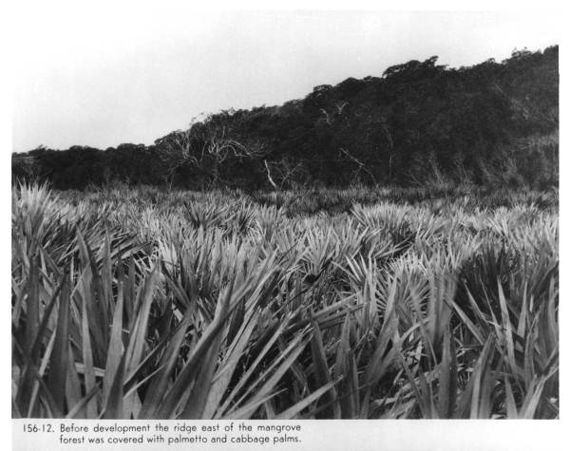
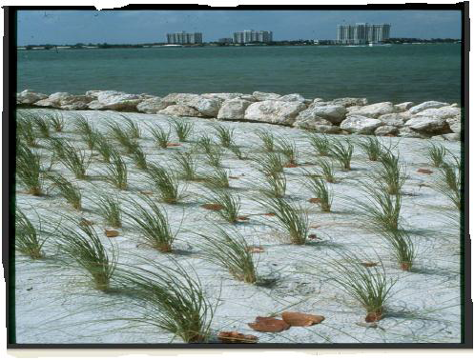
Restoration in Bill Baggs Park
Restoration of mangrove forest, freshwater wetlands, and fore-dune communities was completed with good success.
Restoration of palmetto scrub ecosystem (lower left) buried under filled land was not attempted. Instead, Australian pines were replaced by several transitional & upland tree species (below, center).
Notes:
In a broad sense, the restoration was a great success in increasing the biotic diversity of the Park.
However, due to the cost and disruption of removing fill from the Park, instead of restoring the low scrub communities that characterized the island, an appropriate native tree canopy was substituted.

Slide 8
All vegetation in the urban matrix is influenced by humans, the environment, and ecological legacy
Native Seed Pool
Non-native Plants
Regional Seed Pool
Planting
Natural Dispersal & Colonization Processes
Climate/water regime
Vegetation
Vegetation Management
Substrate/Physiography
Natural Disturbance
Notes:
Task was to examine tree communities on the island, focusing on intra-island variation.
One standard approach, which we did take, is to compare and contrast the canopies in pre-determined areas defined by their similarities and differences in land use. We divided the islands into four such areas: Bill Baggs Park, the Village of Key Biscayne, Crandon Park mangrove forests, and the remaining recreation areas in Crandon.
In doing so, we also wished to consider tree communities throughout KB within the same conceptual model, as they all were influenced by humans in different ways. In our model, vegetation is affected not only by environmental factors and natural disturbance, but also by the mode of regeneration (planting or natural regeneration), the native or non-native origin of the dominant species, and the extent and nature of the tending and management the site receives.

Slide 9
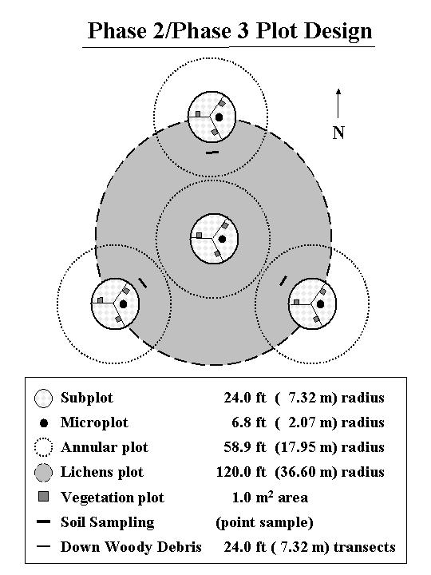
Field & Analytical Methods
USDA Forest Inventory Analysis plot design, with plots randomly selected within mangroves, State Park, County recreational area, and Village of Key Biscayne.
Measured crown dimensions of each tree rooted in 7.32 m subplots, and recorded substrate at 4 locations per subplot.
In Village, determined landowner(s) for each selected plot, contacted them by mail for permission to sample, and followed up with phone calls. Response rate was about 25%, with about 60% of responses positive.
Because of limitation on sampling in the Village, data were analyzed at the sub-plot level.
Used descriptive statistics, reciprocal averaging ordination and gradient analysis techniques to examine forest composition and structure.
Notes:
FIA plots, randomly selected.
Tree crown and substrate.
Permission of residents in Village.
Level of data analysis

Slide 10
Table 1: Tree structural measures in four regions of Key Biscayne, Summer 2011.
 | Region
Structural Measures | Mangroves | Bill Baggs | Crandon | Urban
Crown area*ground area⁻¹ | 132.3ª | 55.5^{b} | 45.1^{b} | 44.2^{b}
Basal Area (m2*ha⁻¹) | 22.1ª | 12.8ª | 13.5ª | 14.5ª
Max Tree Height (m) | 9.71^{ab} | 8.06^{b} | 9.13^{ab} | 9.98ª
Structure & substrate in four Key Biscayne regions:
Minor differences in tree structure, major differences in surface substrates
Substrates
Notes:
Total crown area is not equal to % canopy cover, due to overlap, potential for trees to lean in or out of the plots.
Mangroves with higher crown area, Village with highest tree heights. Otherwise, little to choose.
Substrate differed – high impermeable, grass, and roof in Crandon and especially the Village.

Slide 11
Native and exotic plant representation on the island:
As expected, we found a gradient of increase in the % of exotic species from state park to county park to the urbanized village.
Notes:
Compositional analyses didn’t include mangroves due to their idiosyncratic nature.
Exotic tree species frequency increases from State Park to County Park to Village.

Slide 12
Ordination:
Reciprocal averaging ordination explains only about 12% of variation in presence/absence matrix, equally on Axes 1 and 2.
Divided sites into publically owned sites managed for “natural” values, other Public Spaces, and Private.
Naturally Managed sites (mostly Baggs) grouped together, while Other Public Spaces (mostly Crandon) and Privately Owned spread out from there.
Notes:
Presence/absence basis.
Strength of ordination.
Arrangement of regions, management/ownership types in ordination

Slide 13
Coherence Analysis:
Despite relatively low explanatory power of ordination, when sites and species are arranged along Axis 2 of ordination, they show significant coherence without clumping of borders at community boundaries, i.e., a Gleasonian pattern of species turnover
Species
Species
Native
Exotic
Sites
Natural Mgt
Public space
Private
Sites
a. Betula allegheniensis; b. Cornus florida;
Quercus prinus; d. Pinus virginiana
From Whittaker, 1956. “Vegetation of the Great Smoky Mountains”. Ecol. Mon. 26:1-80.
Notes:
Gradient appears to some extent to be a gradient of increasingly intensive vegetation management, and increasing use of non-native species.

Slide 14
The urban “humanization” gradient
Vegetation
Succession
Disturbance
Physiography
External Environment
Biological/Management Characteristics
Regeneration Source
Biogeographic Origin
Management Intensity
Regional
Seed Pool
Artificial
Regeneration
Non-Native
Native
Non-Native
Native
High
Low
High
Low
Low
High
Low
High
“Humanized” <---------------------- “Natural” ----------------------->“Humanized”
ecosystem ecosystem ecosystem
Notes:
Like most of the world’s ecosystems, to greater or lesser degree, all vegetation on Key Biscayne bears strong imprint of humans, from the state park which differs from the historical landscape but is dominated by native species and natural processes, to the urban area which a highly cultivated mixture of native and non-native plants.

Slide 15
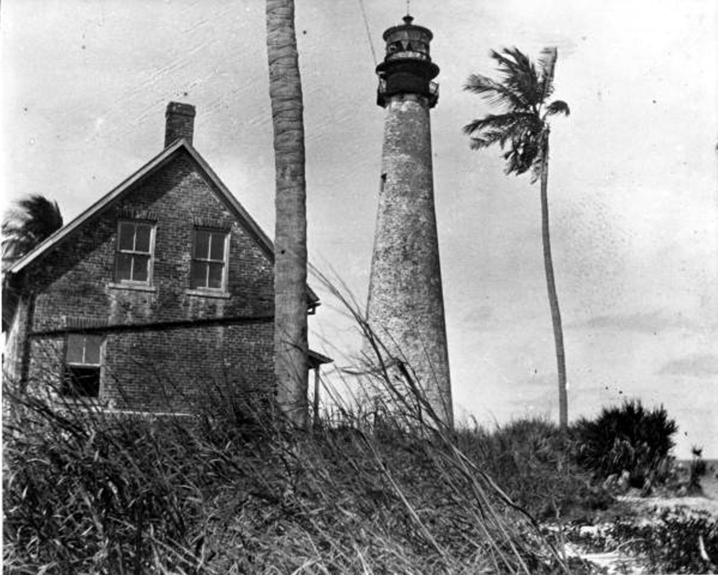
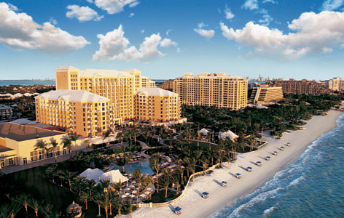
The following students contributed to this study: Jennifer Lopez, Junnio Freixa, Eric Betancourt, Nina De La Rosa, Carmen Rodriguez, Mike Maniloff, Griselda Chavarria, Bleu Waters, Chris Haik, and Dariana Alcantara.
Thanks also to Victor Zuclich (Bill Baggs State Park), Alice Warren (Miami-Dade County), and the many Key Biscayne residents who invited us into their backyards.
Notes:
In attempting to understand changing vegetation patterns and their significance in places in humans, climate and substrate

