Slide 1
Are we getting closer? Rethinking “local” through ethical place-making
Billy Hall
Ph. D Student
Global & Sociocultural Studies Florida International University
Notes:
Sometimes it will seem that im not talking about local “food” but I am, we need to think about our locality
Talking about something more than environmentally sustainable, but socially sustainable
We are the source for food consumed globally (Badia spices)
Im going to look at what characterizes access to food in South Florida

Slide 2
The emergence of “local” food
“Think global, act local”
“Locavore” was the 2007 word of the year in the Oxford American Dictionary
Local food hailed by the likes of Vandana Shiva, Michael Pollan, Barbara Kingsolver, Joel Salatin
Local food systems:
- reduce food miles/GHG emissions/oil dependency
- allow for fresher and more varied fruits and vegetables
promote and strengthen local economies
People are thus thinking geographically and taking geography seriously
Notes:
“Think global, act local” phrase has been used in town planning since the early 20th century and in environmental contexts since the early 70s
Local food hailed by the likes of Vandana Shiva, Michael Pollan, Barbara Kingsolver, Joel Salatin
- conventional agriculture is unsustainable and socially and ecologically exploitative
Local food systems:
- reduce food miles/GHG emissions/oil dependency
- allow for fresher and more varied vegetables and fruits that might otherwise perish in transit
promote and strengthen local economies

Slide 3
Outline
Show research on well-being and food hardship
Highlight aspects of Miami-Dade’s economic, physical, and cultural geography
Discuss possibilities for reframing “local”
Suggest a few “local” policy objectives

Slide 4
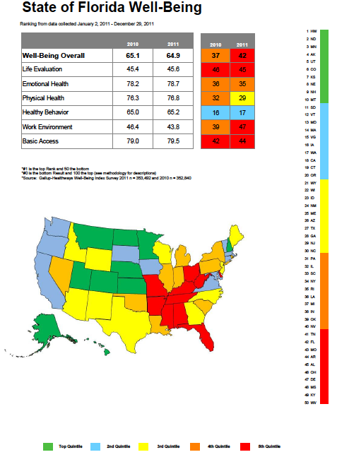

Slide 5
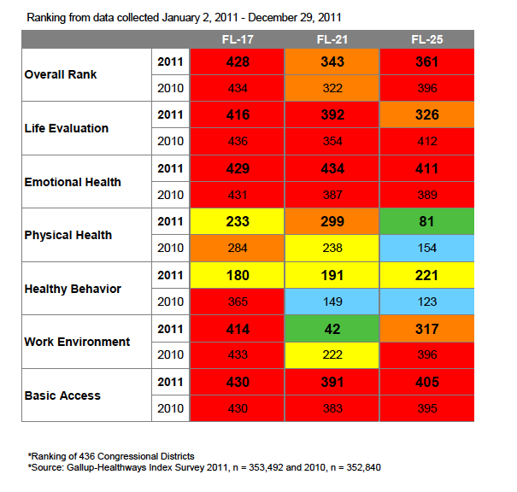
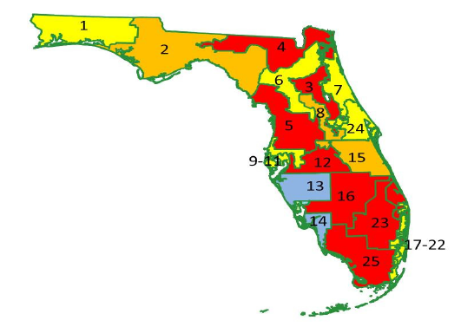
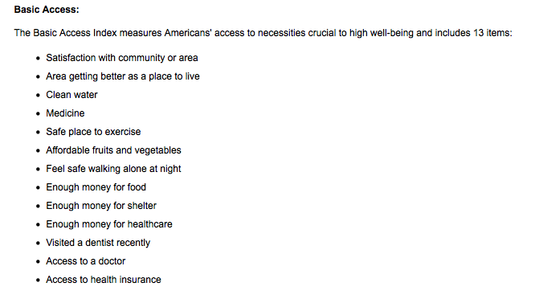
Notes:
Physical health metrics look at whether people are ill or feeling well
Healthy Behavior includes smoking/nonsmoking, vegetable and fruit consumption, and regular exercise
So some improvements were made between 2010-2011 (if we trust the accuracy of the survey)
However, basic access has stayed the same or worsened in all of the districts

Slide 6
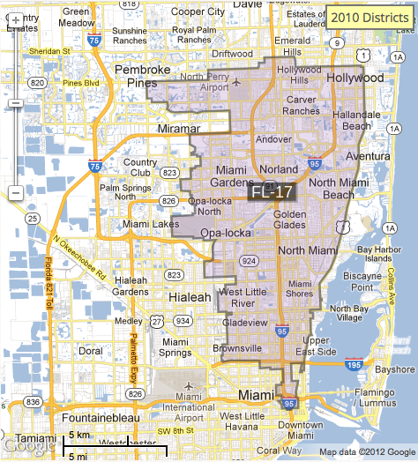
Notes:
As we know, conditions within each district are not homogenous but vary by neighborhood and household.
Also note the areas not include along the coast of biscayne bay, Miami Beach

Slide 7
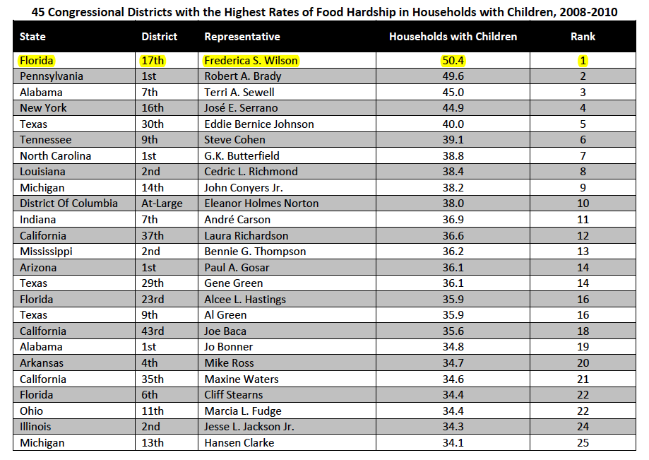
Notes:
FRAC is the leading organization that conducts research on food hardship in the US.

Slide 8
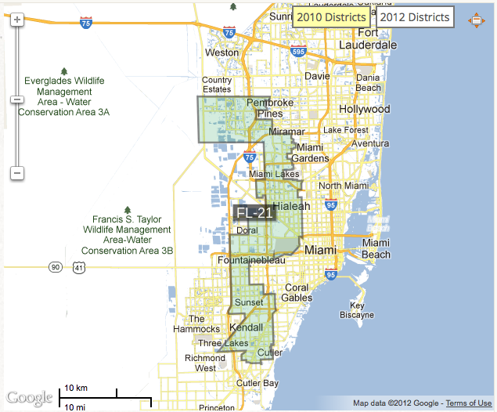

Slide 9
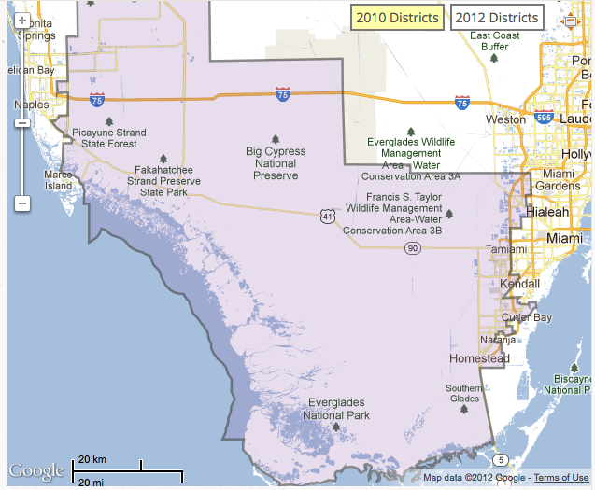
Notes:
Mention imokalee

Slide 10
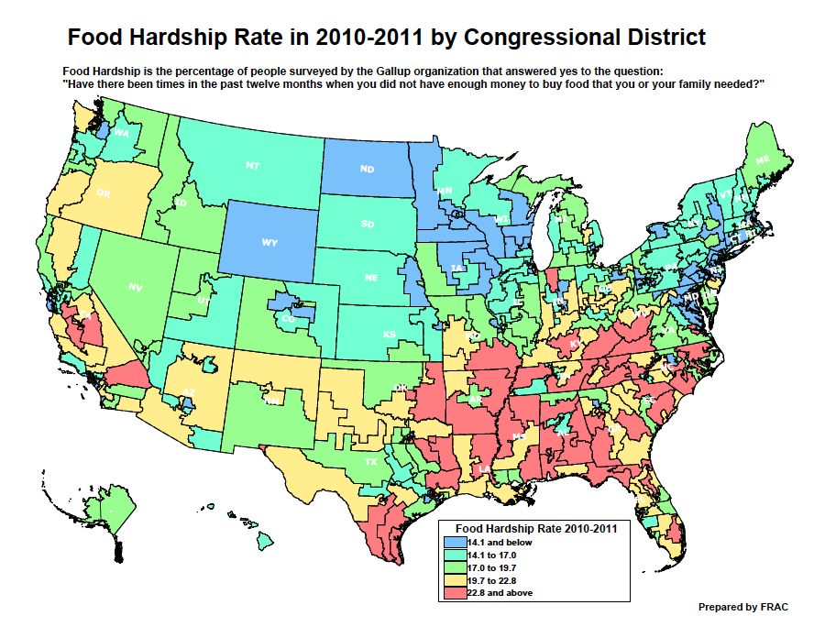

Slide 11
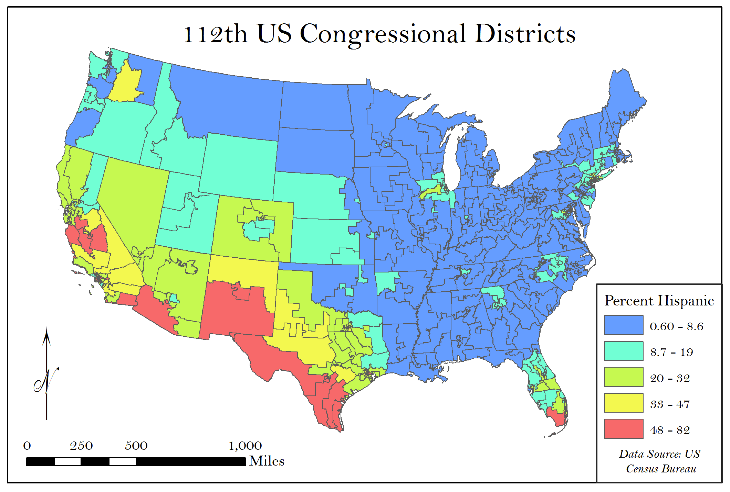
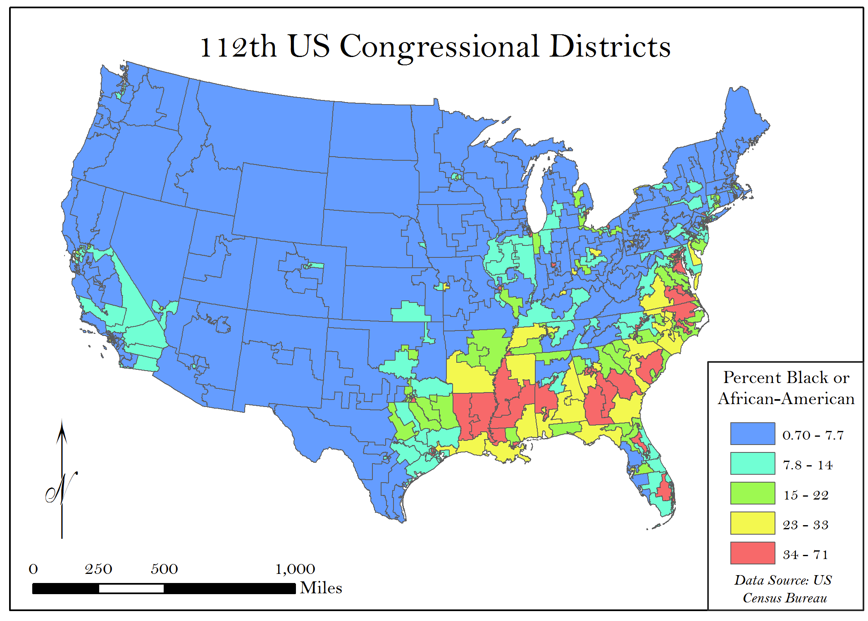
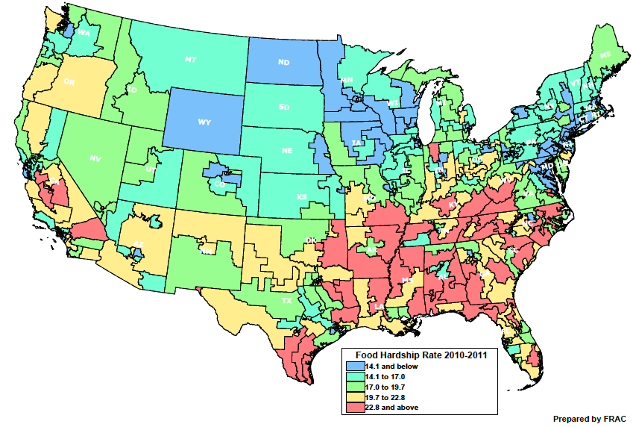

Slide 12
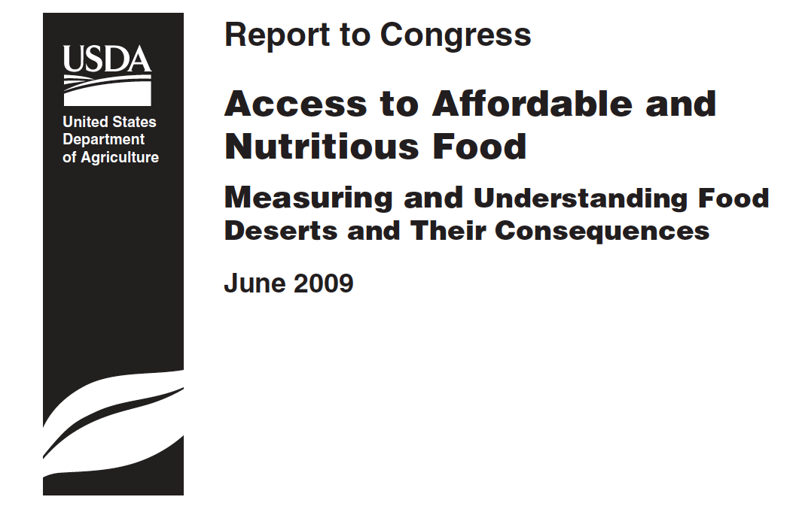
“Urban core areas with limited food access are characterized by higher levels of racial segregation and greater income inequality” (page iii)
“Segregation by race and income inequality are the dominant predictors among all neighborhood and household context variables that predict low-, medium-, and high-access levels” (page 44).
“Overall, ethnic and racial minorities have better access to supermarkets
than Whites. Median distance to the nearest supermarket for non-White individuals is 0.63 miles, compared with 0.96 miles on average for Whites … These differences do not consider income, only race/ethnicity” (page 18).

Slide 13
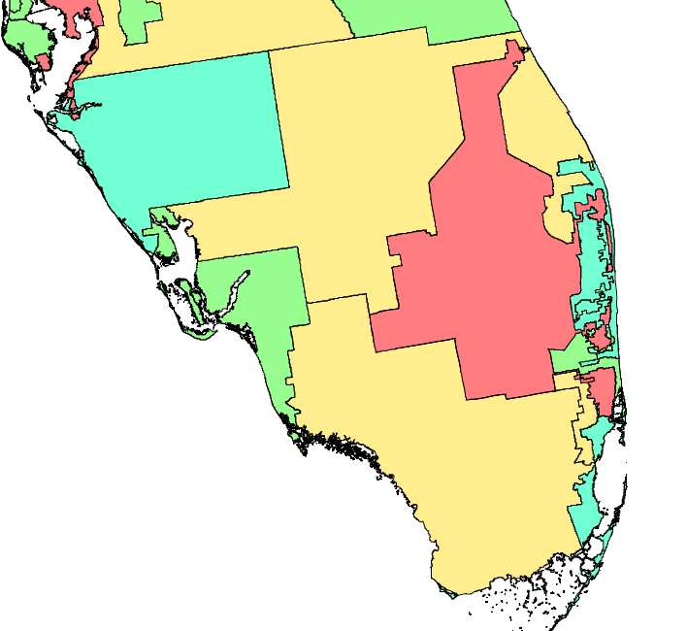
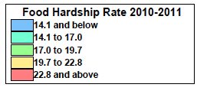
Notes:
Should mention that this is not the most fine grained analysis that could be produced, but is the most comprehensive we have yet. For example FL district 18 contains coconut grove, coral gables, south miami, pinecrest, goulds, and parts of east Homestead appears to be doing well, but we know that the neighborhoods are very different.

Slide 14
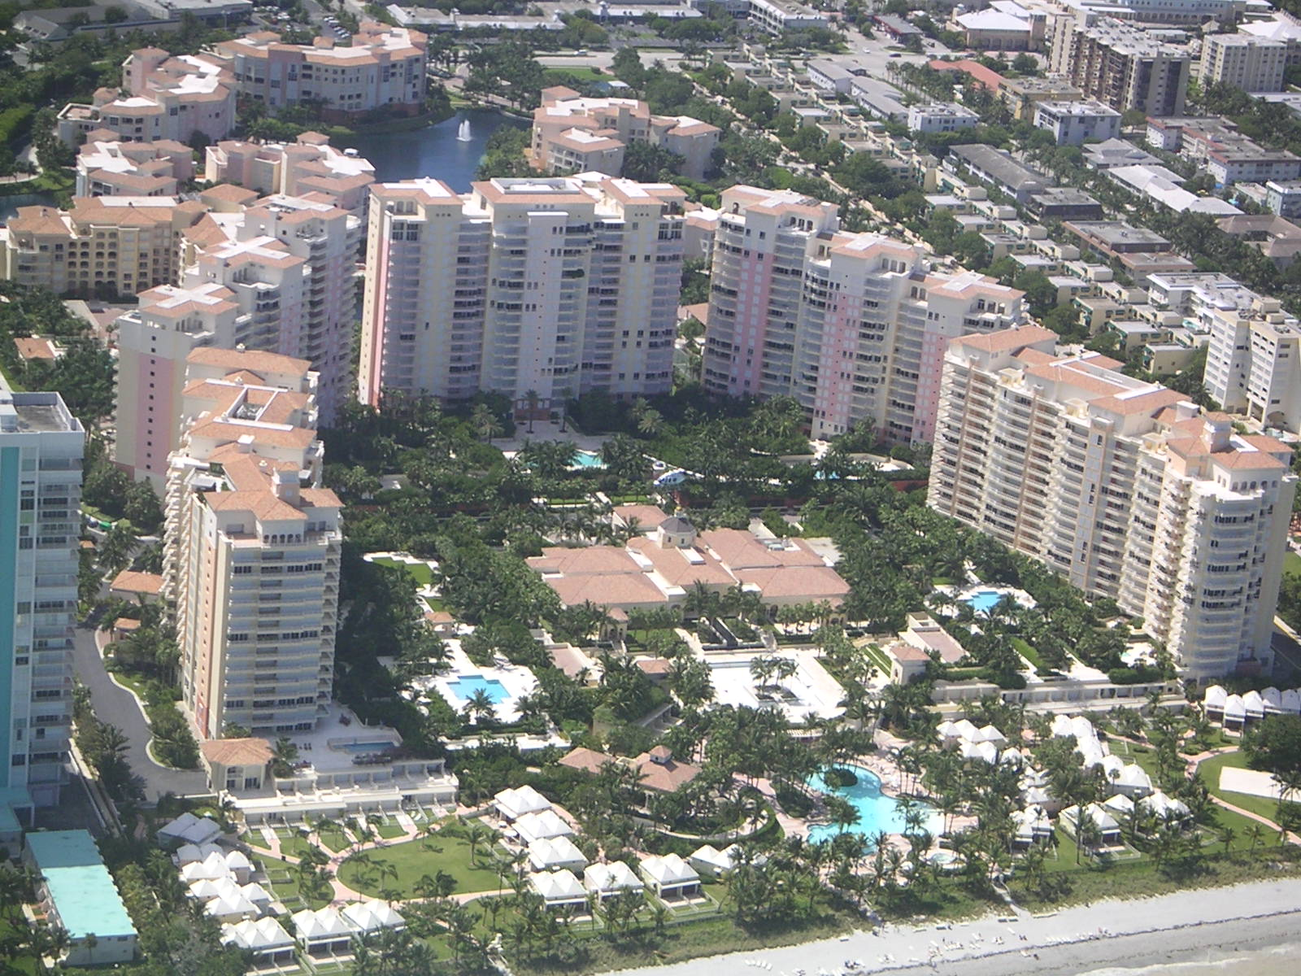
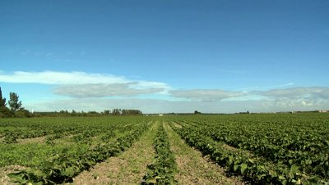
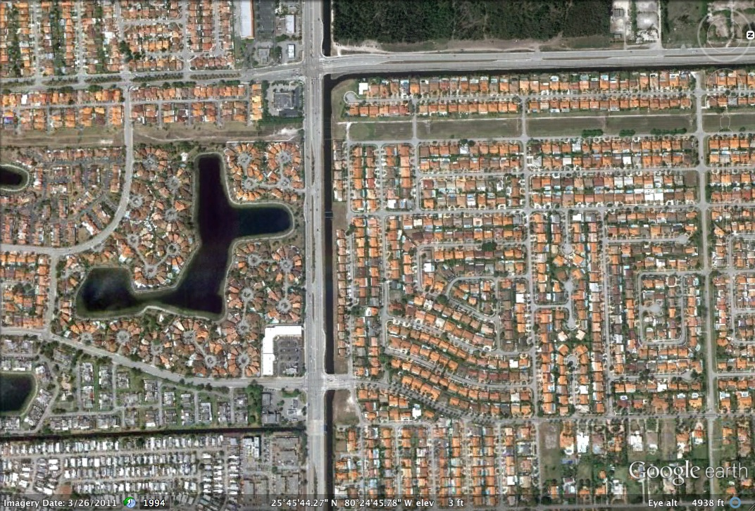
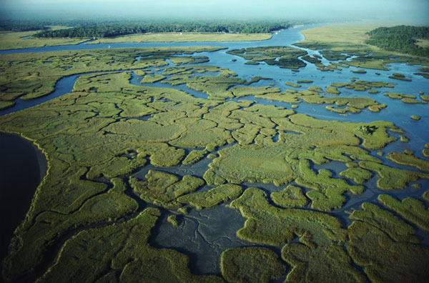
Physical Geography
Natural environment:
Located in the tropics at the tip of a peninsula
Flat landscape, low elevation
Situated between two national parks
Built environment:
Rural – Suburban – Urban
“Dense but fenced”
Notes:
runs gamut from dense urban to suburban to rural
(sprawling but disconnected due to canals and gated communities)
Unique opportunities (tropics with high productivity); open land in the city;
Multifaceted local food system – lots of potential, water supply, AND its characterized as the greatest in terms of food hardship

Slide 15
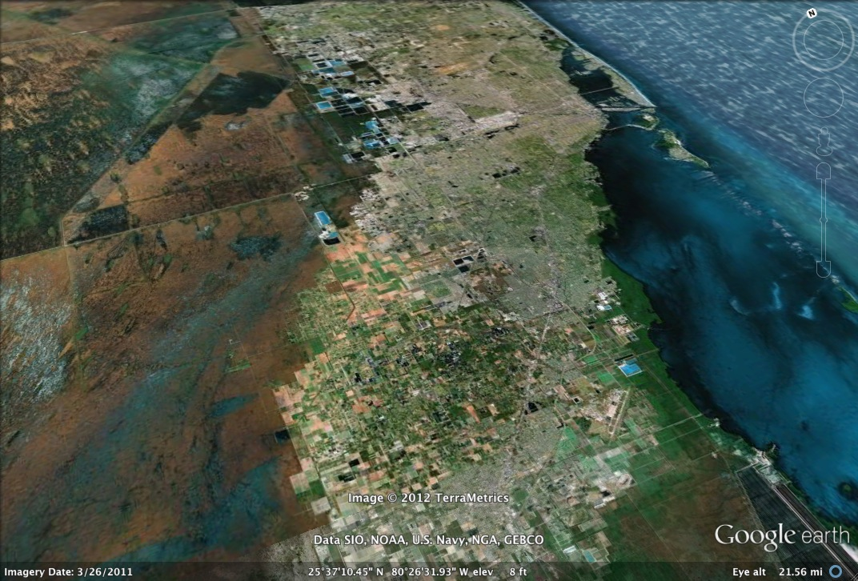

Slide 16
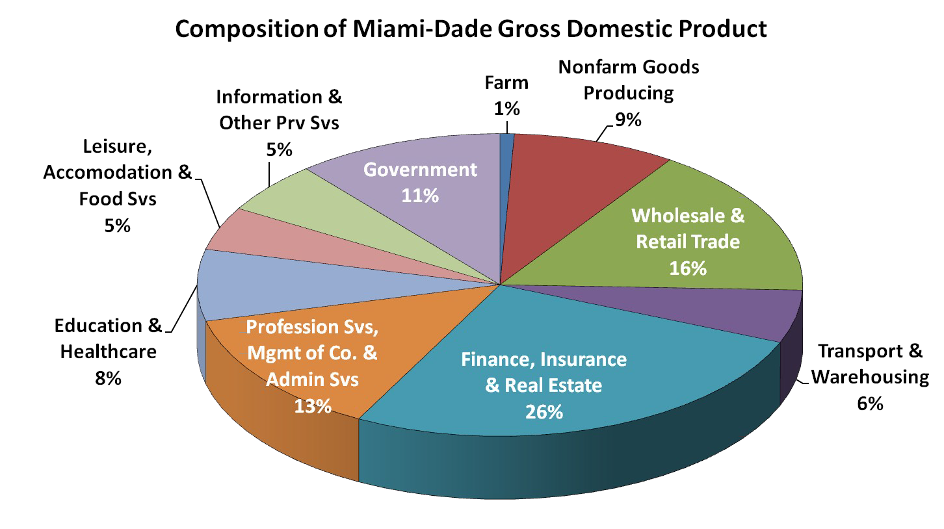
Economic Geography
Of the 25 most populous
counties, Miami-Dade has the
2nd highest level of income
inequality.
170 Multinationals
headquartered in Miami
GDP of Miami-Dade:
$111.5 billion
Port of Miami imports and
exports both value over $1
trillion per year (economic
impact to S. Fl. Local
economy is $14 billion)
2008

Slide 17
Cultural Geography
Over 50% foreign born
156 nationalities
104 languages spoken
64.5% Hispanic
19.3% Black
16% non-Hispanic White
12 million overnight visitors annually

Slide 18
What does “local” mean to us?
How can we incorporate the elements of our complex urban region into a conception of “local”?
How can we develop a framework for “local” that connects people of different historical backgrounds?
In what ways can we be more political through our use of “local”?
Notes:
the city’s cultural
diversity, its historical development, its
relation to unique ecosystems, and its
embeddedness in global flows and
connections

Slide 19
Reimagining a “local” Miami
Taking a critical look at “local”
Generating multiple perspectives
Involving disenfranchised communities
Developing measures for evaluating processes
Caring-at-a-distance
Notes:
Understanding how place-making processes cut people off, we also read places that we arent part of differently
Taking a critical look at “local”: are local processes inherently just/sustainable? Are extralocal/global processes inherently destructive/exploitative?
Generating multiple perspectives and understandings of “local” from diverse locals
Involving disenfranchised communities in the process of place-making
Developing measures for evaluating those processes (both local and extralocal) that foster healthy, sustainable communities
Caring-at-a-distance: how can we build a coalition with extralocal communities that have similar struggles?

Slide 21
“…there is growing evidence that documents the success of non-health interventions that have had a positive impact on health (e.g., improvements to road networks and investments in public transportation options), particularly for those living in deprived areas” (page 47)
Notes:
so in the last few minutes i want to take a hint from the USDA report and think about ways to complement the efforts of our local food movement

Slide 22
Connecting vision with policy and practice
Some of the factors that can bring change to our local food system and improve food access involve reshaping the conditions of low-income, minority neighborhoods. This includes:
Improving access to affordable housing
Improving transportation infrastructure
Increasing funding and resources for public schools
Reducing income inequalities and barriers for living-wage job entry
Enabling greater participation in SNAP programs
Improving access to health care
Decriminalizing petty crimes/Developing productive alternatives to incarceration
Notes:
from this i've come up with a few suggestions for things we might think about

Slide 23
Special thanks to:
Mario Yanez for putting this all together
and
Dr. Gail Hollander for the super solid advising
This research is supported by the National Science Foundation through the Miami-Dade Urban Long Term Research Area Exploratory Grant No. BCS-0948988.
Notes:
the city’s cultural
diversity, its historical development, its
relation to unique ecosystems, and its
embeddedness in global flows and
connections

